Slide 1
Microsoft Word Resources Add In
Leader: Michael Hicks
Members: Sam Bennett, William Lai, Isaac Elizarraz, Michael Bishara, Newton Le

Slide 2

Hypertext Markup Language (HTML)
Standard Markup Language for documents that are displayed in a web browser.
It can be used in conjunction with scripting services such as CSS and Javascript. This allows programs to be imbedded into web pages which gives them improved features.
HTML documents are received from web servers or local storage and render the documents into multimedia web pages.
Type code is TEXT and format is document file format.
Notes:
Sam

Slide 3

JavaScript
Popular scripting language used in web pages.
Especially useful for dynamic changes of content, image manipulation, and form validation.
Works well in combination with HTML using the <script> tag
<script> blocks can contain scripts in the HTML file or point to scripts outside of the file; it is more common to see the latter
Notes:
Sam

Slide 4
Functionality (Goals)
Improve user experience on Microsoft Word by allowing the capability to browse 3rd-party tools
Attract more users to use Word’s functions
Gathering all useful tools/buttons into one specific area
Tools include Numworks, Desmos, Wolframalpha, common CPP references
Promotes side-by-side view of your scientific report and mathematical tools/references
Saves time and effort
Notes:
Will

Slide 5

Microsoft Word
Creating functionable add-on for Microsoft Word requires 2 simple things: an official Office license and Visual Studios
Has existing “Get Add-ins” and “My Add-ins” features
Display your own features through the “Open Add On Task Pane”
Task pane gives user access to interface controls that run code
Has security limitations which we will discuss in the next slide
Notes:
Will

Slide 6

MATLAB
The original goal of the MATLAB implementation was to use the program in the add-on
This is where the first security related issues were realized
Since access to MATLAB is server based and licensed locked it is not possible to access through the add-on
MATLAB as well as other websites/apps that utilize server stored information do not allow embedded usage
This poses a security risk to their software and user base through risks of exploitation and hacking
Notes:
Isaac

Slide 7
Process/Procedure
We utilized the workspace inside of Visual Studios that is made for Microsoft products to create ours.
We combined HTML, CSS (Cascading Style Sheets), and JavaScript.
We used HTML to load in the JavaScript scripts and design the layout of the task pane.
The HTML had an embed / iframe function within it.
The JavaScript was called in the head of the HTML and was used to control various aspects of the HTML file by using buttons. The HTML is used as the layout of the task pane while the JS was used to control the buttons and directly modify the HTML iframe embed.
Notes:
Michael H.

Slide 8
iFrame
An older method of embedding websites into HTML. A more modern version of the method is called embed.
Since this is an outdated form of embedding web pages, there can be security issues for login-based websites so many websites block embedding functionality.
This option allows for customizable dimensions to allow for more functions and website embedding to be included in the Word Task Pane.
Notes:
Newton Le

Slide 9
Testing/Debugging
When testing, we first tried making the entire panel MATLAB online, which allowed us to access it, but did not allow extra functionality.
Due to security reasons, we were unable to embed MATLAB into the task pane, so we instead chose websites that had open embedding usage.
Additionally, formatting the HTML to have each button and sentence in the correct place was part of the testing process.
Notes:
Michael B.

Slide 10
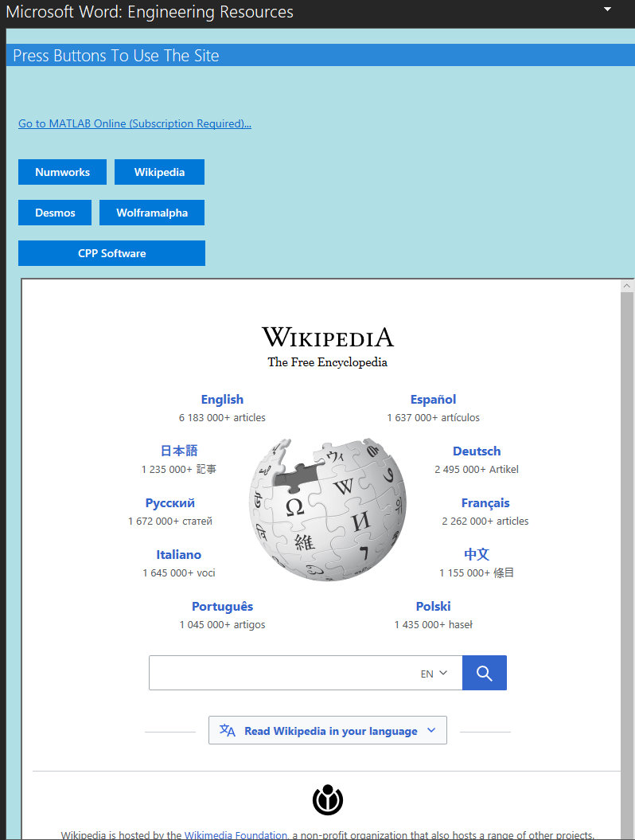
Results
Since we had to choose alternative websites to embed, we chose NetWorks, Wikipedia, Desmos, Wolframalpha and the CPP Software page.
Clicking each button brings the user to the appropriate website within the panel.
There is also a link that takes you to the browser version of MATLAB since it could not be embedded.
The overall task pane in an adjustable size so it can be resized to variable resolution in Word.
Each website retains full functionality within the add-in.
Notes:
Michael B.

Slide 11
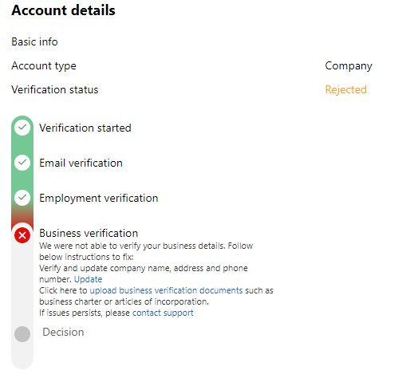
Microsoft Certification
and
Publishing
Issues
Microsoft will not allow any developers to place products on the add in store without being an established company.
Notes:
Michael H. / Isaac

